Slide 1


PRESENTATION ON INTERNSHIP PROJECT
HOUSING PRICES
Under the guidance of :
Dept of CSE
ATMECE, Mysuru
Presented By :
DANIEL D ( 4AD18CS017 )
MOHAMMED ANAS ( 4AD18CS040 )
Project Batch-4 Team-1

Slide 2
CONTENTS:
1. Overview
2. Technologies Used
3. Module Wise Breakup
4. Explanation
5. Data Extraction
6. Data Cleaning
7. Data Vizualization
8. Summary

Slide 3
OVERVIEW
As each sector of the market is growing, data is building up day by day, we need to keep the record of the data which can be helpful for the analytics and evaluation.
Housing prices is considered primarily during purchasing any house, either to live in it or to rent it out.
This dataset is used to analyze house prices in California based on parameters of Longitude and Latitude.
Before analyzing and visualization we need the raw data, and this raw data can be gathered from different open-source data websites available on the internet like “Kaggle”.
This data will be in raw CSV form, it may be individual subunits of data or the complete dataset containing all the groups of files.
Our project applies principles of data analytics over large existing data sets to effectively predict.
WEBSITE LINK: https://www.kaggle.com/datasets/camnugent/california-housing-prices

Slide 4


TECHNOLOGIES USED
Python
Python is the programming language of choice for data scientists.
Although it wasn't the first primary programming language, its popularity has grown throughout the years.
Jupyter Notebook
It is the original web application for creating and sharing computational documents. It offers a simple, streamlined, document-centric experience.
It is one of the most popular code editors used by data scientists today.
Its application makes creating and sharing notebooks simple, as well as performing end-to-end data science workflows in a single document

Slide 5




TECHNOLOGIES USED CONT…
LIBRARIES IMPORTED
NumPy is a library used for working with arrays
Pandas is used for data science/data analysis and machine learning tasks.
Matplotlib is a comprehensive library for creating static, animated, and interactive visualizations in Python
Seaborn is a data visualization library based on matplotlib.

Slide 6
MODULE WISE BREAKUP
Data analysis contains the following stages:
IDENTIFY
COLLECT
ANALYZE
CLEAN
INTERPRET
It defines the organizational goals, and planning a lucrative solution is the first step in the analytics process.
It is need to collect transactional business data and customer-related information from the past few years to address the problems your business is facing.
It is the data you collect will often be disorderly, messy, and contain unwanted missing values
It is to gather the right data, the next vital step is to execute exploratory data analysis
It is the final step is to interpret the results and validate if the outcomes meet your expectations
6

Slide 7
EXPLAINATION
In this module we first gather data (dataset). Data comes in all forms, most of it being very messy and unstructured. They rarely come ready to use.
Datasets are either large and small, and comes with a variety of issues, invalid fields, missing and additional values, and values that are in forms different from the one we require.
In order to bring it to workable or structured form, we need to “clean” our data, and make it ready to use.
This dataset is used to predict whether a house prices of a property is likely to get increase or decrease based on the input parameters like longitude and latitude etc.
We will analyze the dataset and we will perform some of the Data cleaning operation, and then we will plot the graphs based on the observation.

Slide 8
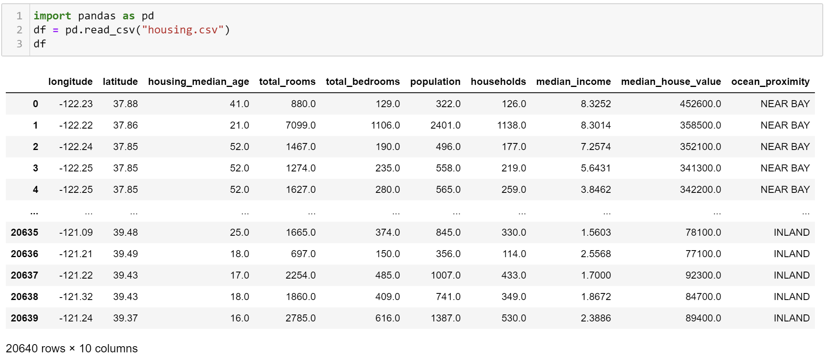
EXTRACTING THE DATA
Is to import the dataset with the help of read_csv() function we are importing csv file to variable name dataset.

Slide 9
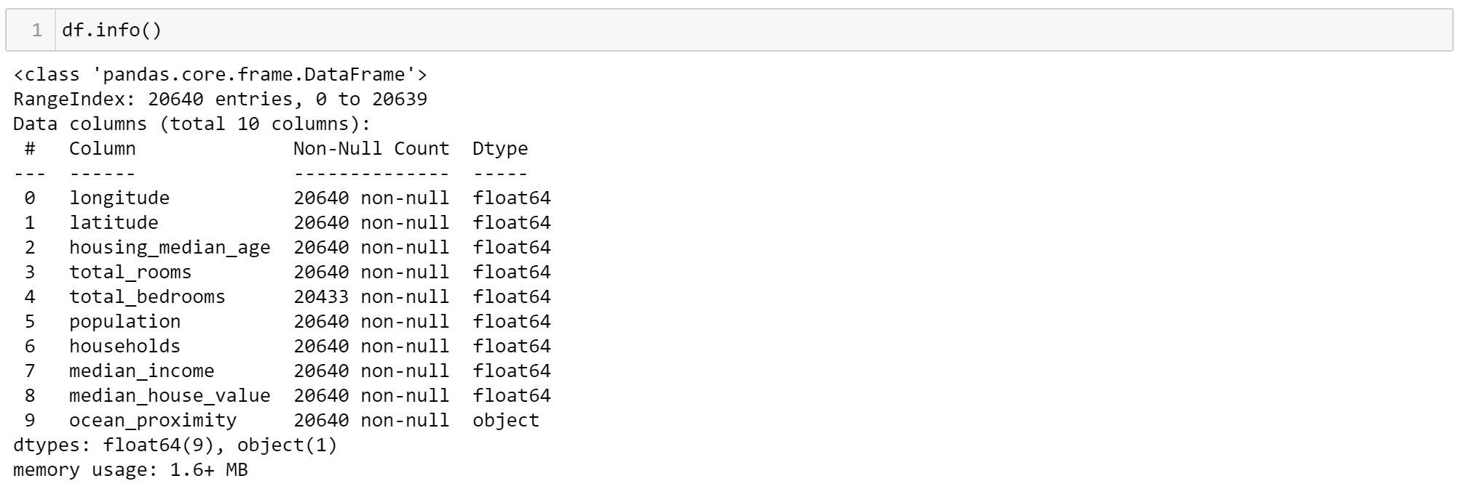
DATA CLEANING
info()
The data has no null values and according to the standard deviation, there are no wrong, outlier data.
It also we can able to see the List of column’s.
It also we can able to see the there is no null values.

Slide 10
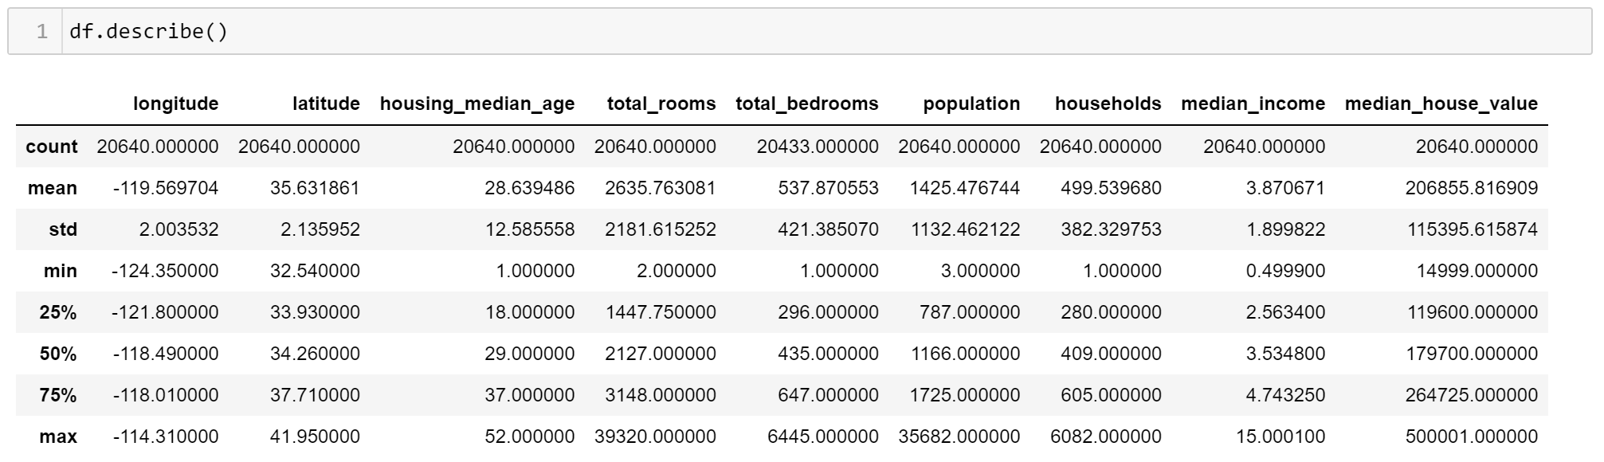
DATA CLEANING CONT…
describe()
From the above figure we can see that using the describe() function.
We can able to clean the data in as mean,median ,min,max etc.
Only we will get the above values if the column contains numerical values.

Slide 11
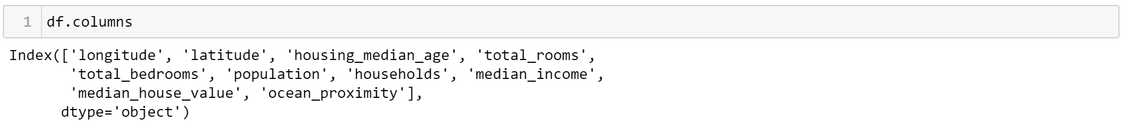
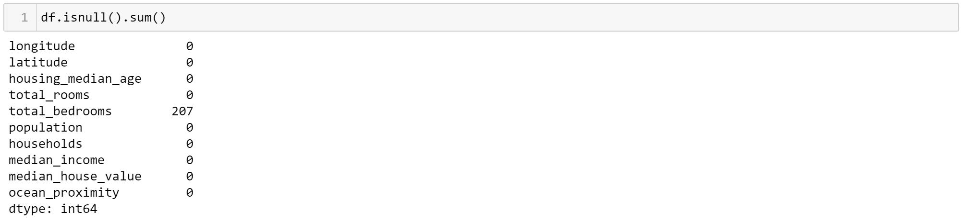
DATA CLEANING CONT…
columns()
Columns present in CSV file
dupicated()
There is no Duplicated values
isnull()
Isnull is represented

Slide 12
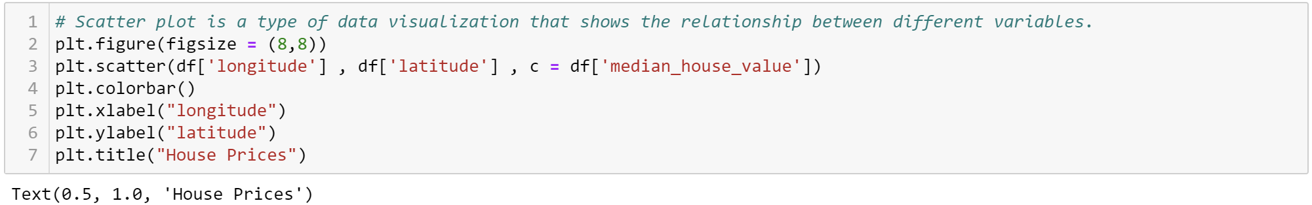
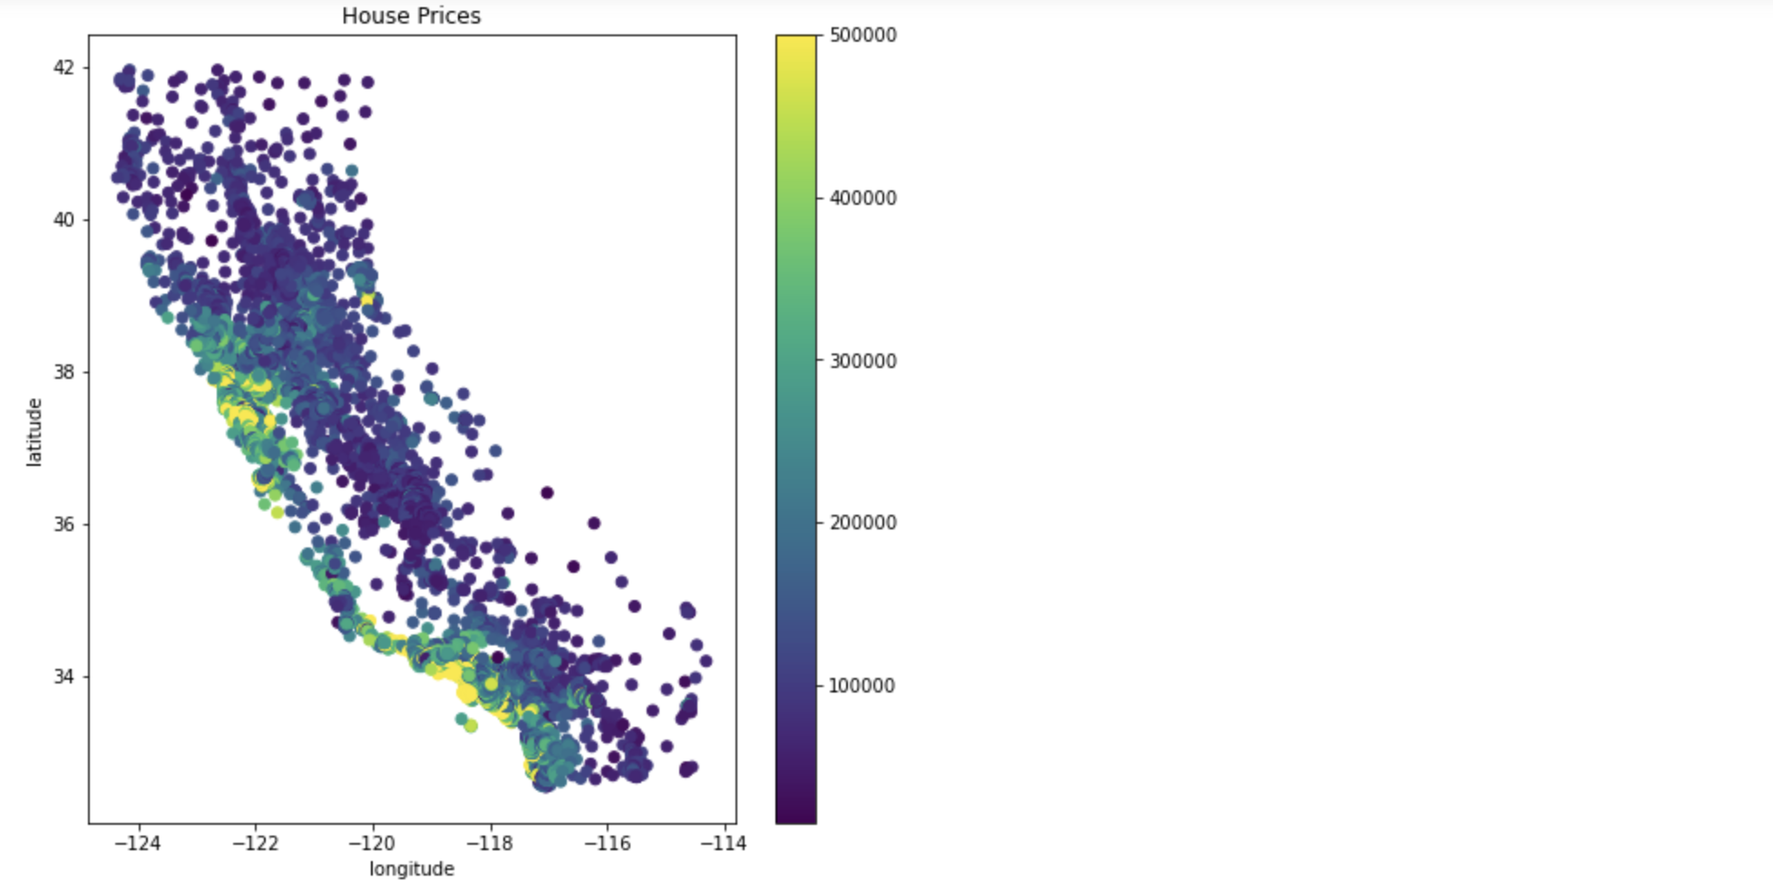
DATA VIZUALIZATION
SCATTER PLOT
Graph is plotted on the basis of Latitude and Longitude of California

Slide 13
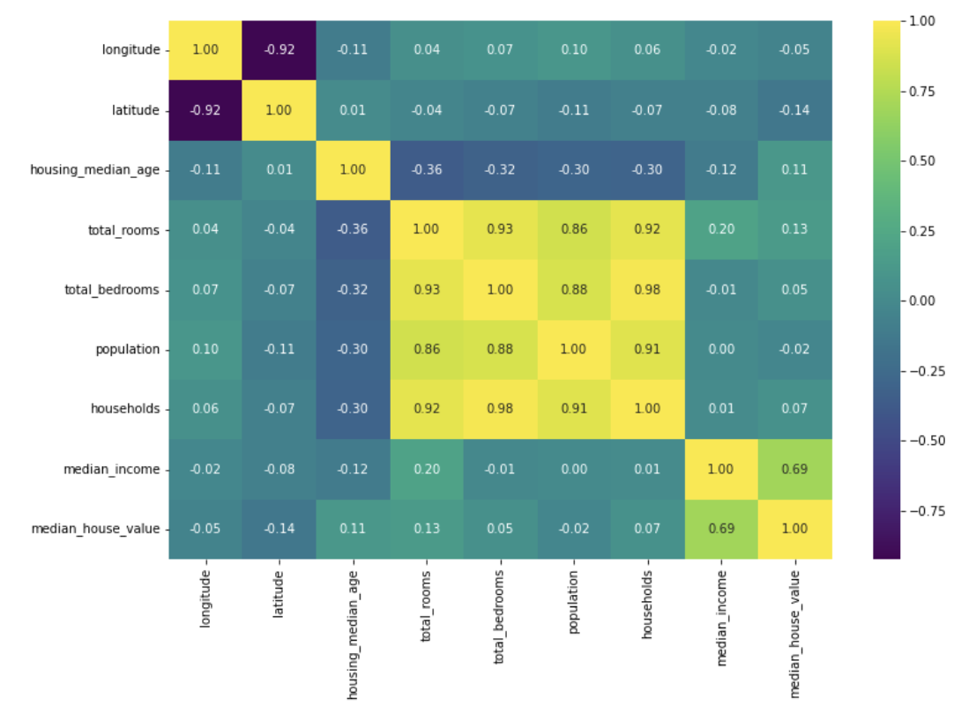
DATA VIZUALIZATION CONT…
HEATMAP
Target variable median_house_value is very mildly correlated to all but one feature here median_income, so one might outline this as an important feature.

Slide 14
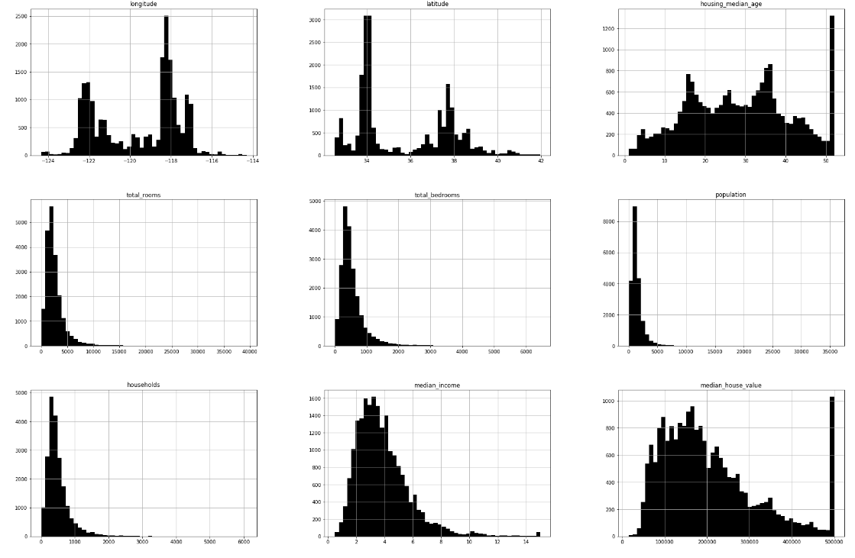
DATA VIZUALIZATION CONT…
HISTOGRAM
It is used to observe the data Distribution

Slide 15
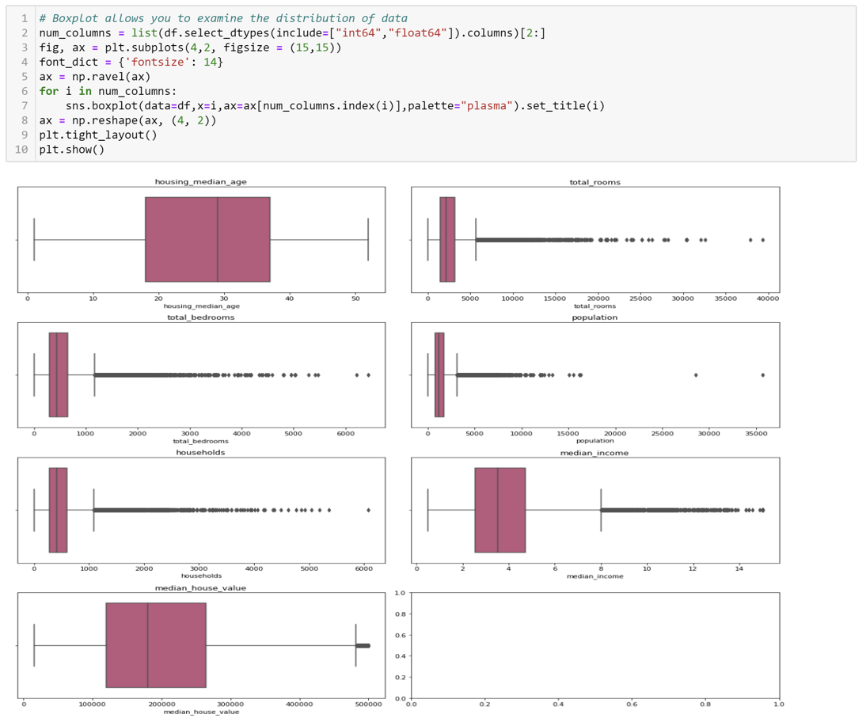
DATA VIZUALIZATION CONT…
BOXPLOT
It is used to examine the
Data Distribution

Slide 16
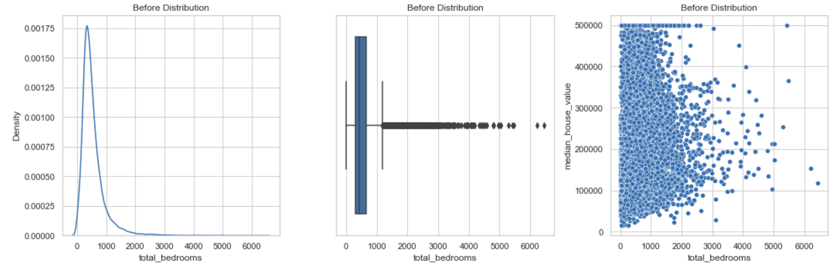
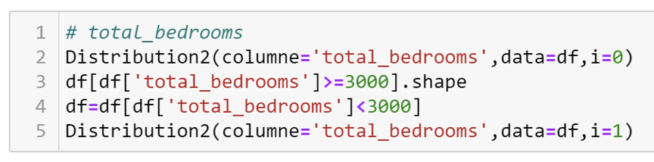
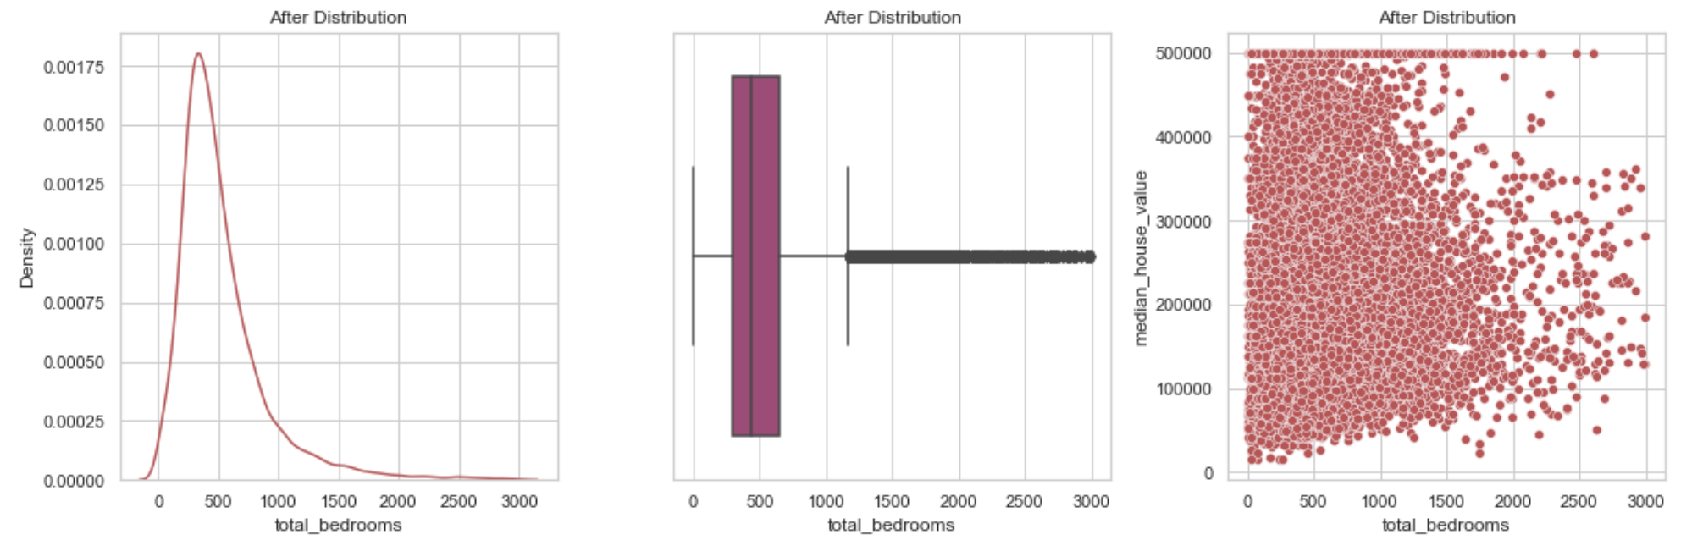
DATA VIZUALIZATION CONT…
DISTRIBUTION
Further it can also be used to analyze other data if required

Slide 17
SUMMARY
This project applies principles of data analytics over large existing data sets for Housing Prices to get lowest and highest housing prices in California.
Here are few suggestions which is purely based on subjective & objective data analysis of the Housing Prices.
According to the dataset, the success of any real estate agencies depends on its availability of the property so it is purely based on subjective and objective data analysis of the Housing prices.
The availability of a particular property to a potential buyer can be increased if agent provides with a proper marketing strategy. Can provide better view of room and other related data.
The planning of needed number of available properties can improve customer interaction. This can be accomplished by using the predictive study of the data and hiring real estate agents from the local agencies.

Slide 18
NOTE This project is converted into “Menu Driven Program” This we be explained.

Slide 19


